Slide 1
Discover Security Vulnerabilities in it services
PRESENTED BY Shivraj Hirave

Slide 2
CONTENTS
1. Executive summary
2. Project Scope
3. VAPT for Zerobank Network
Centralized directory services - scanning, identifying users and their passwords and Jxplorer tool
Centralized logging services
Website - Phishing attack
VAPT on remote access service – Unauthentic access
4. VAPT on web application and its databases
Cross site scripting(XSS)
SQL Injection
Extracting databases using sqlmap
5. Challenges

Slide 3
Executive Summary
TechNest LLC is a leading software solutions provider in Silicon Valley, California. During the past few months, TechNest LLC’s clients, Zero Bank and Mutillidae, have been facing cyberattacks. Critical client data have been lost due to these attacks.
Our organisation have been asked to conduct a VAPT on the infrastructure of Zero Bank and Mutillidae, which is the client networks and create a report to highlight the various vulnerabilities.

Slide 4
Project Scope
VAPT on Zero Bank’s Network
VAPT on Mutillidae Web Application
VAPT on Mutillidae Database System
Network Information –
IP | Role | OS
192.168.137.10 | Pentester’s Machine | Kali Linux
192.168.50.58 | Centralized Directory | Windows Server 2019 (domain.local)
192.168.137.68 | Log Server | Ubuntu
192.168.137.60 | Windows Client | Windows-7

Slide 5
Zero Bank –
Website of Zero Bank | http://zero.webappsecurity.com/login.html
Mutillidae –
http://192.168.137.63/mutillidae/index.php
http://192.168.137.63/mutillidae/index.php?page=user-info.php

Slide 6
What is Vulnerability Assessment?
It is a systematic review of security weaknesses in an information system. It evaluates if the system is susceptible to any know vulnerabilities, assigns severity levels to those vulnerabilities and recommends remediation or mitigation, if and whenever needed.
Vulnerability assessment refers to the process of identifying risks and vulnerabilities in computer networks, systems, hardware, applications and other parts of the IT ecosystem.

Slide 7
What is Penetration Testing?
A penetration test, also known as a pen test, is a simulated cyber attack against your computer system to check for exploitable vulnerabilities. In the context of web application security, penetration testing is commonly used to augment a web application firewall.
Penetration testers use the same tools, techniques, and processes as attackers to find and demonstrate the business impacts of weaknesses in a system. Penetration tests usually simulate a variety of attacks that could threaten a business.

Slide 8
Zero Bank’s Centralized Directory Service
Directory Server provides a central repository for storing and managing information. Almost any kind of information can be stored, from identity profiles and access privileges to information about application and network resources, printers, network devices and manufactured parts. Information stored in Directory Server can be used for the authentication and authorization of users to enable secure access to enterprise and Internet services and applications.
A flaw was found in the way Samba, as an Active Directory Domain Controller, implemented Kerberos name-based authentication. The Samba AD DC, could become confused about the user ticket represents if it did not strictly require a Kerberos PAC and always use the SIDs found within. The result could include total domain compromise.

Slide 9
TOOLS USED FOR SCANNING AND EXPLOITATION OF ACTICE DIRECTORY SERVICES
1) Nmap –
Using nmap -A indicates aggressive it will let us know the extra information’s like OS Detection (-O), version detection, script scanning (-sC), and traceroute (-traceroute) even it provides a lot of valuable information about the host. Here -A gives me information about open ports, services, and also DNS_Domain_Name which is useful for Kerberos_enumuser.
2) Nessus –
Nessus is a remote security scanning tool, which scans a computer and raises an alert if it discovers any vulnerabilities that malicious hacker could use to gain access to any computer you have connected to a network.
3) Metasploit –
It allows testers to scan systems for vulnerabilities, conduct network reconnaissance, launch exploit, and more. It has a large number of exploit modules, including buffer overflow and SQL injection exploits.

Slide 10
4) JXplorer –
JXplorer is a free, open-source client for browsing Lightweight Directory Access Protocol (LDAP) servers and LDAP Data Interchange Format (LDIF) files. Directory services store the users, passwords and computer accounts and share that information with other entities on the network.

Slide 11
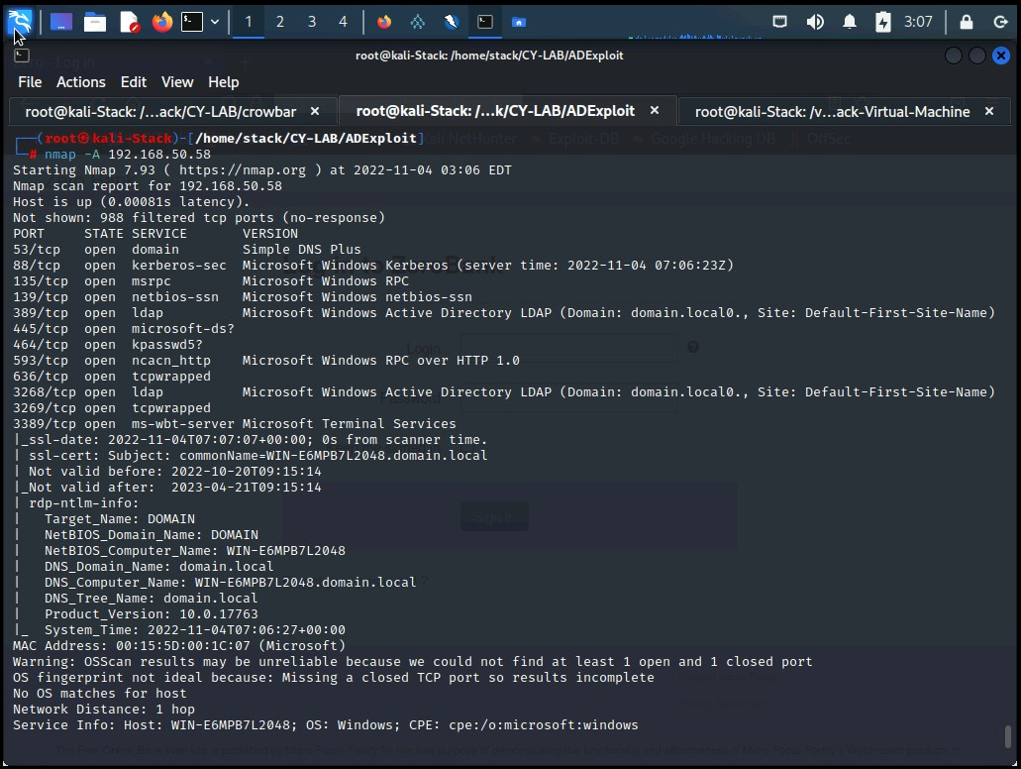
NMAP SCANNING
Notes:
THROUGH NMAP AGGRESSIVE SCANNING WE FOUND THAT THE LDAP PORT NUMBER 389 IS OPEN AND IT IS VULENERABLE

Slide 12
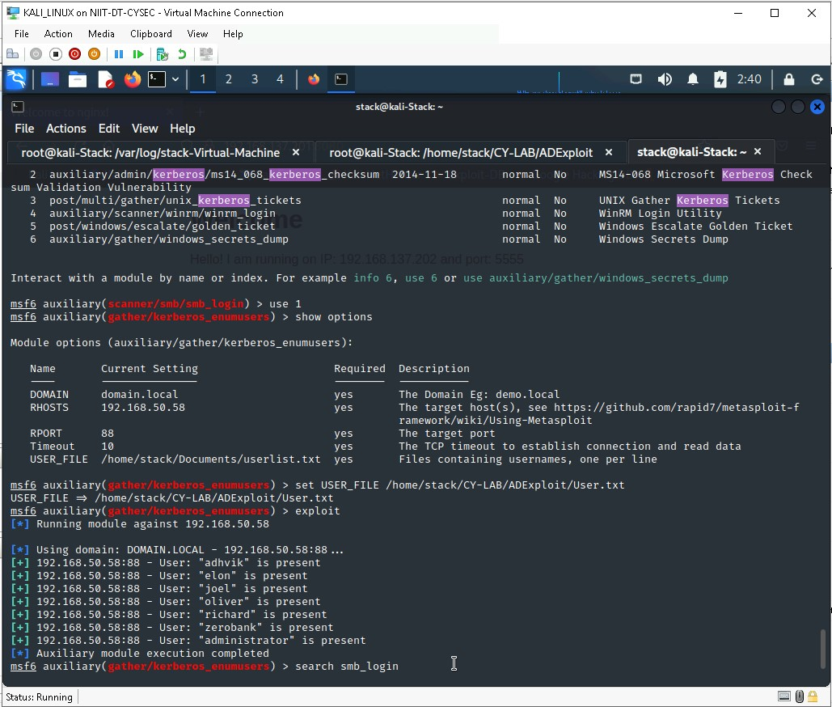
EXPLOITATION OF ACTIVE DIRECTORY USERS
Kerberos user enumeration using Metasploit - Kerberos_enumusers module

Slide 13
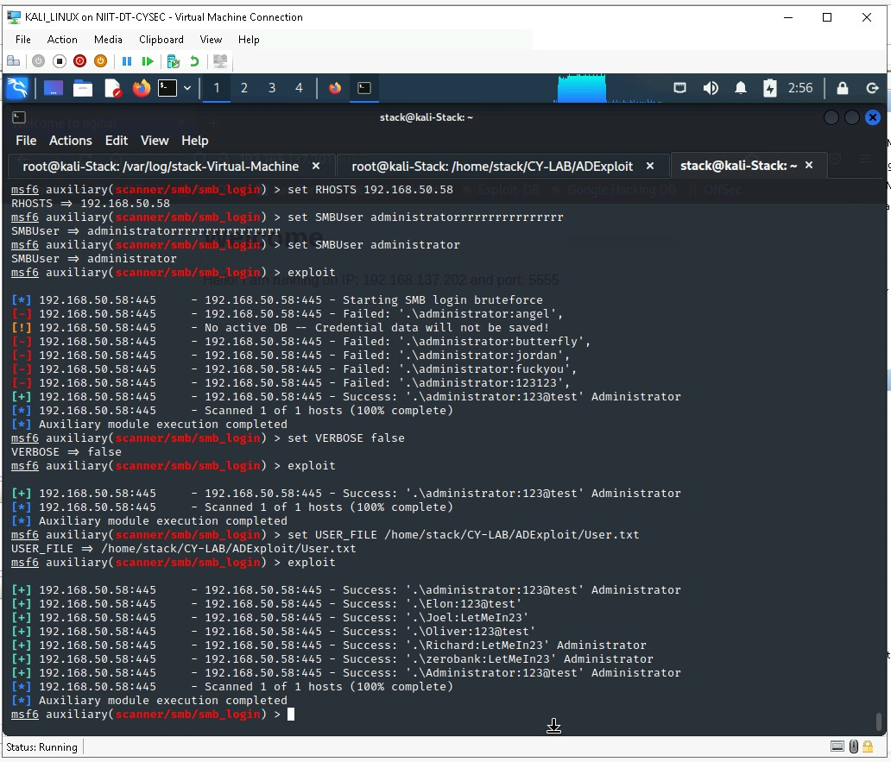
EXTRACTING USERS PASSWORDS
Extracting users passwords using
Metasploit – smb_loging

Slide 14
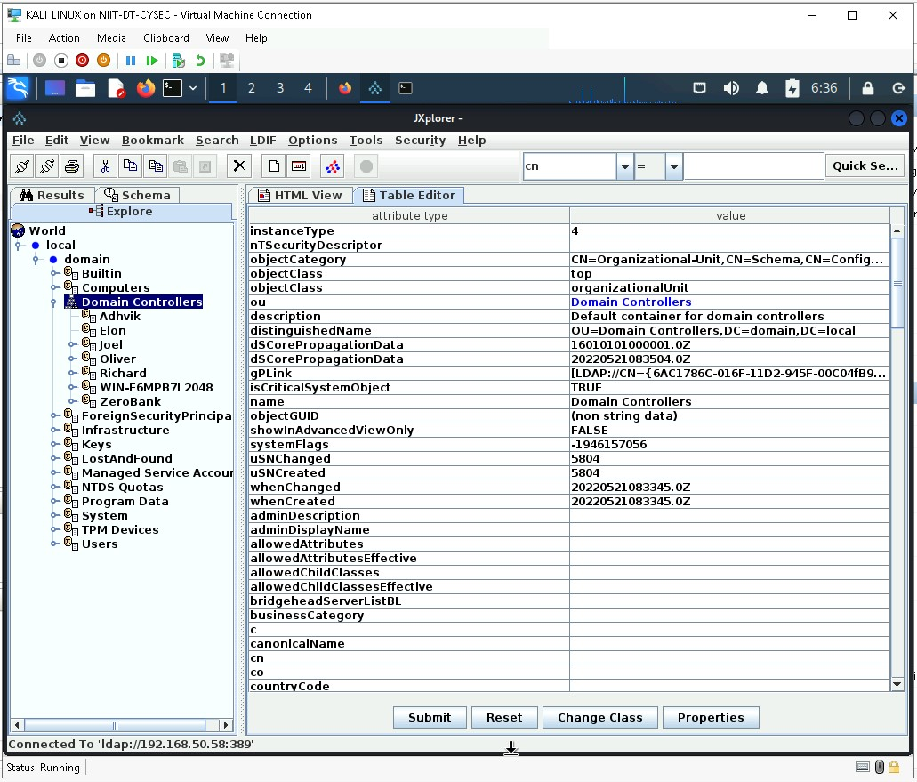
JXPLORER TOOL
DC=domain,DC=local
Ip=192.168.50.58
UserDN=Richard
Password=LetMeIn23
Notes:
From this screenshots we can see that we entered to the user adhvik

Slide 15
Security Impact
Attacker can search, navigate and modify contents.
Attacker can read directory schema and can easily edit subtrees.

Slide 16
SECURITY Mitigations
Enable AES Kerberos encryption (or another stronger encryption algorithm), rather than RC4, where possible.
Ensure strong password length (ideally 25+ characters) and complexity for service accounts and that these passwords periodically expire. Also consider using Group Managed Service Accounts or another third party product such as password vaulting.
Limit service accounts to minimal required privileges, including membership in privileged groups such as Domain Administrators.
Limit credential overlap across systems to prevent the damage of credential compromise and reduce the adversary's ability to perform Lateral Movement between systems.
Enforce the principle of least-privilege. Do not allow a domain user to be in the local administrator group on multiple systems.
Look for suspicious account behavior across systems that share accounts, either user, admin, or service accounts. Examples: one account logged into multiple systems simultaneously; multiple accounts logged into the same machine simultaneously; accounts logged in at odd times or outside of business hours. Activity may be from interactive login sessions or process ownership from accounts being used to execute binaries on a remote system as a particular account.

Slide 17
Zero Bank’s Logging Service
Log management is crucial for any businesses who have to handle large volumes of log data from multiple sources. Logging as a service allows you to partner with a managed service provider who can offer the centralized, formalized database of data you need, but without the work that it takes to set up your own log management system and without using the resources you might be able to better devote to other processes.
Currently zero banks server logging service is not exploitable. The resources are isolated from other systems.

Slide 18
Rsyslog
Rsyslog is the default logging program in Debian and Red Hat Linux. Rsyslog stands for the rocket-fast system for log processing. It is an extension of the original syslog protocol, with additional features such as flexible configuration, rich filtering capabilities and content-based filtering.

Slide 19
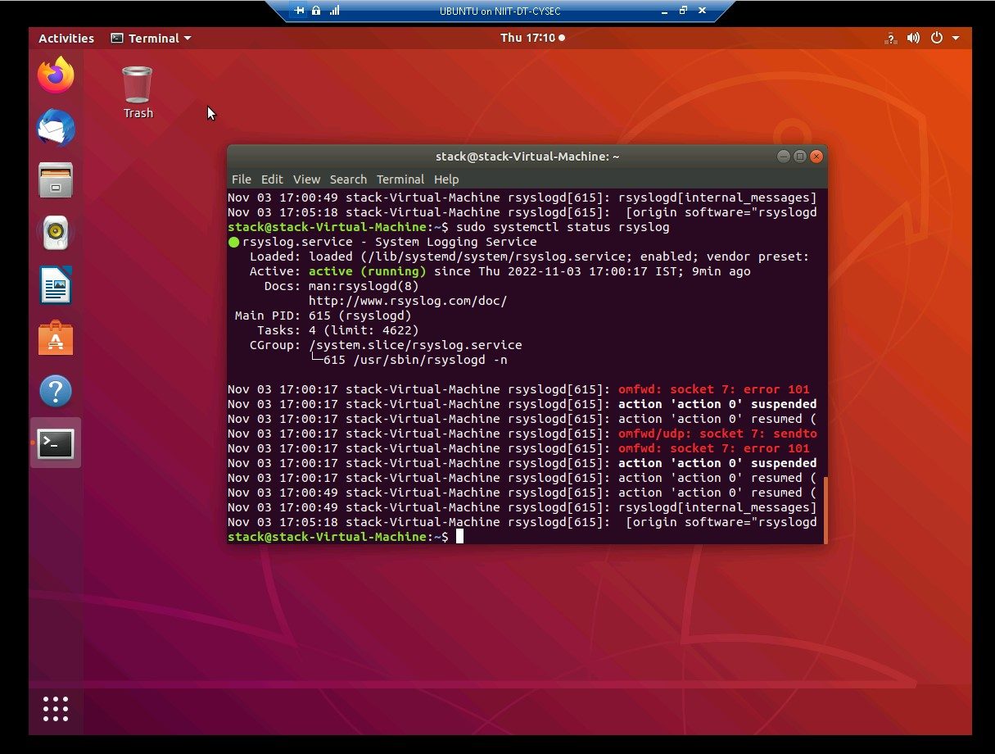
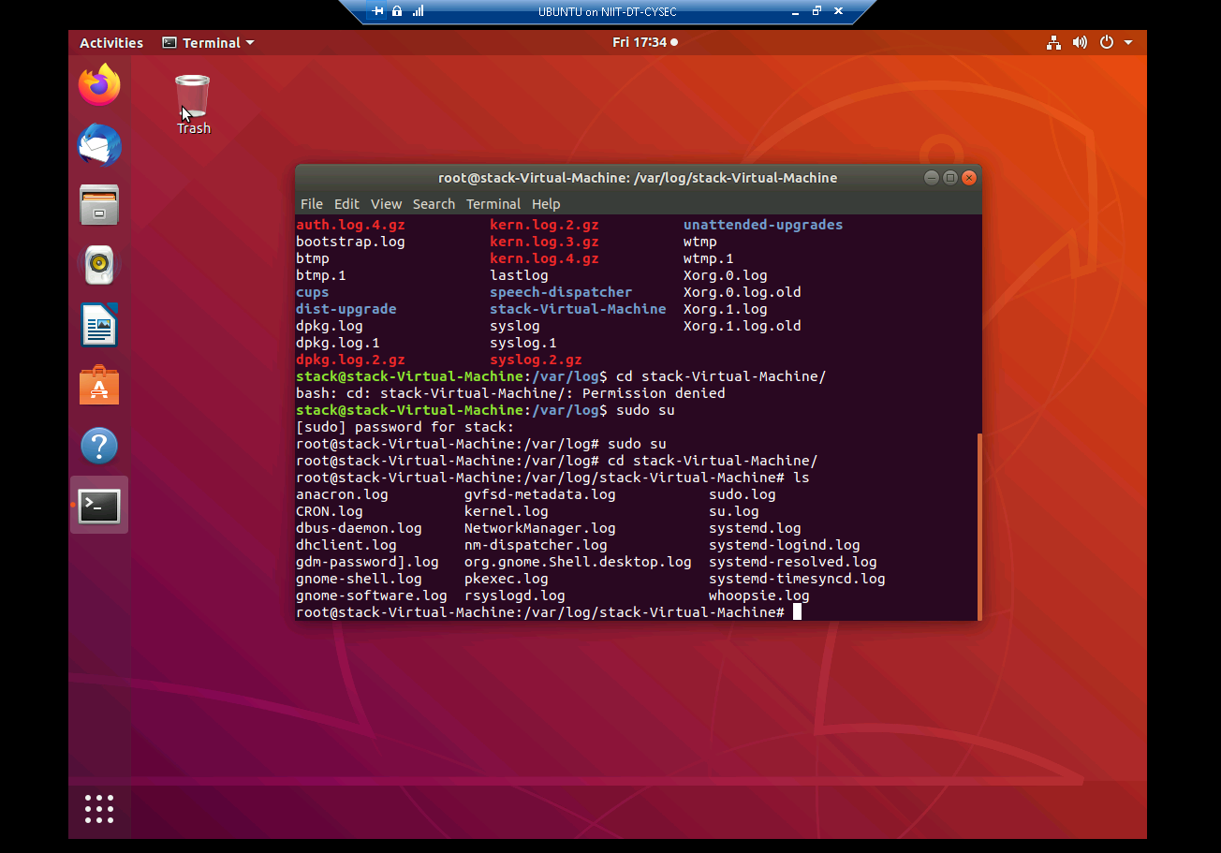

Slide 20
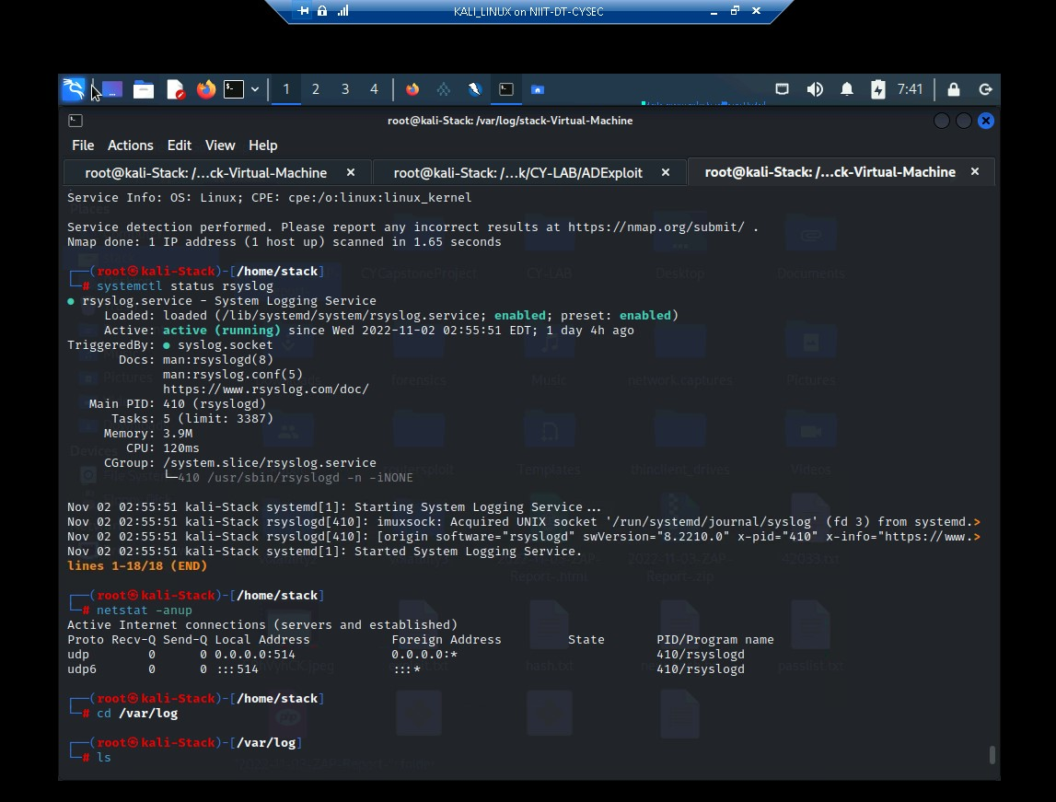
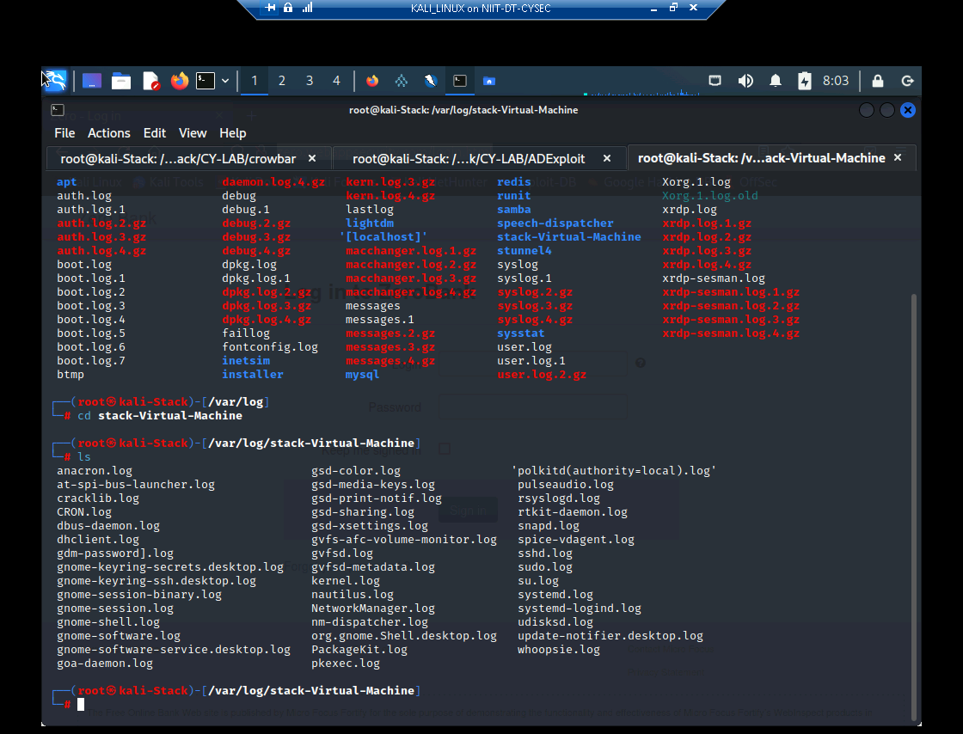

Slide 21
Zero Bank’s Website
Zero Banks website is a financial institution and it has faced almost three times more cyberattacks than any other industry.
Cybercriminals try to gain access to the banking network in order to compromise data or steal identity or financial information. Here we have tested zero banks website using phishing attack. It is one of the oldest scams on the internet. It has become so common that every user and business has likely seen multiple phishing pages, knowingly or not.

Slide 22
PHISHING ATTACK
Phishing is a type of social engineering attack often used to steal user data, including login credentials and credit card numbers. It occurs when an attacker, masquerading as a trusted entity, dupes a victim into opening an email, instant message, or text message.
SEToolkit –
The social-engineering toolkit is an open-source penetration testing framework designed for social engineering. SET has many custom attack vectors that allow you to make a believable attack quickly.

Slide 23
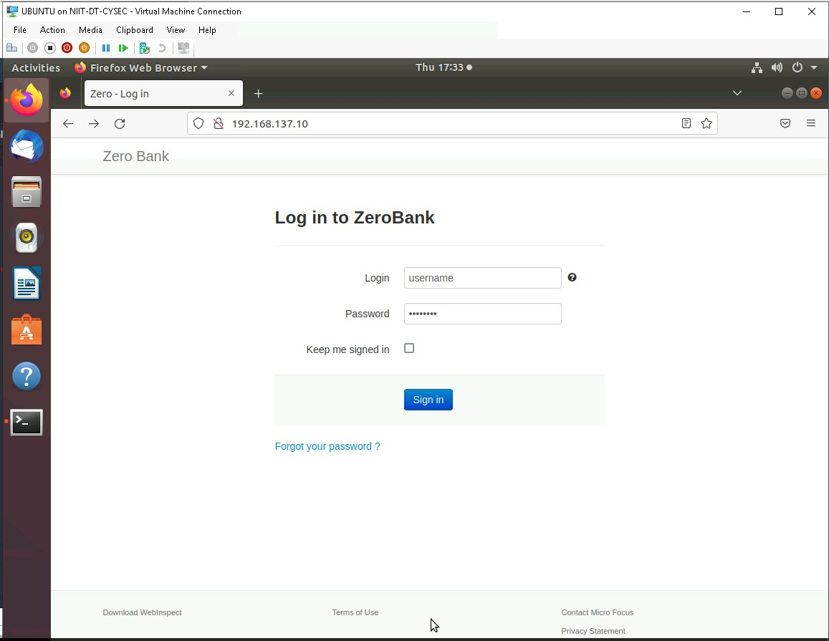

Slide 24
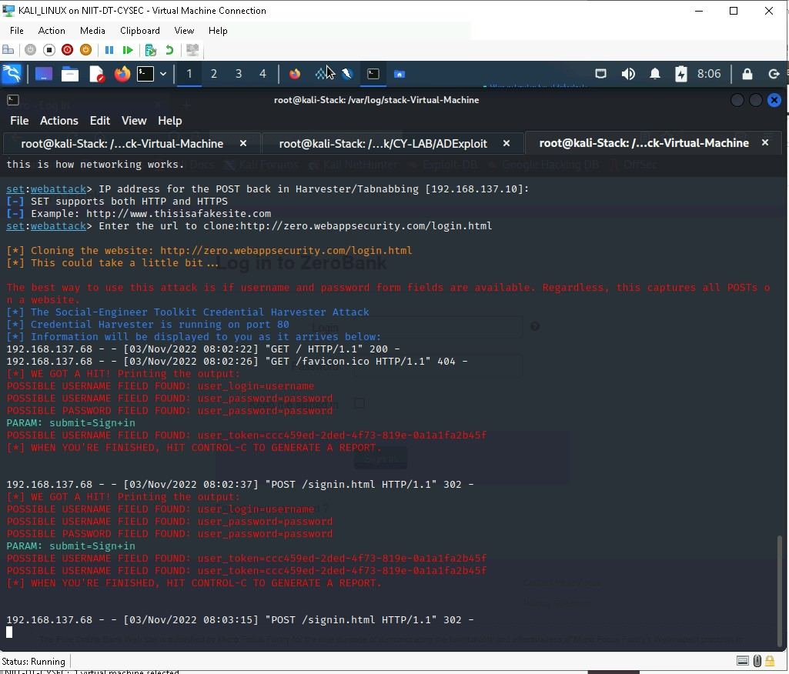

Slide 25
Security Impact
Such an attack typically sustains severe financial losses in addition to declining market share, reputation, and consumer trust. Depending on scope, a phishing attempt might escalate into a security incident from which a business will have a difficult time recovering.

Slide 26
SECURITY Mitigations TO PREVENT PHISHING ATTACKS
Use an application firewall that can detect attacks against this weakness. It can be beneficial in cases in which the code cannot be fixed (because it is controlled by a third party), as an emergency prevention measure while more comprehensive software assurance measures are applied, or to provide defense in depth.
It’s generally not advisable to click on a link in an email or instant message, even if you know the sender. To bare minimum you should be doing is hovering over the link to see if the destination is the correct one.
Most browsers nowadays will enable you to download add-ons that spot the signs of a malicious website or alert you about known phishing sites. They are usually completely free so there’s no reason not to have this installed on every device in your organization.
If you’ve got online accounts, you should get into the habit of regularly rotating your passwords so that you prevent an attacker from gaining unlimited access. Your accounts may have been compromised without you knowing, so adding that extra layer of protection through password rotation can prevent ongoing attacks and lock out potential attackers.
Arrange security awareness training to employees of the organization to prevent and mitigate user risk.
Use Valid SSL certificate to keep user data secure, verify ownership of the website, prevent attackers from creating a fake version of the site, and convey trust to users.

Slide 27
ZERO BANK’S REMOTE ACCESS SERVICE
Remote Access service is any combination of hardware and software to enable the remote access tools or information that typically reside on a network of IT device.
It gives the ability to access your business software and communications technologies from beyond your company’s local network.

Slide 28
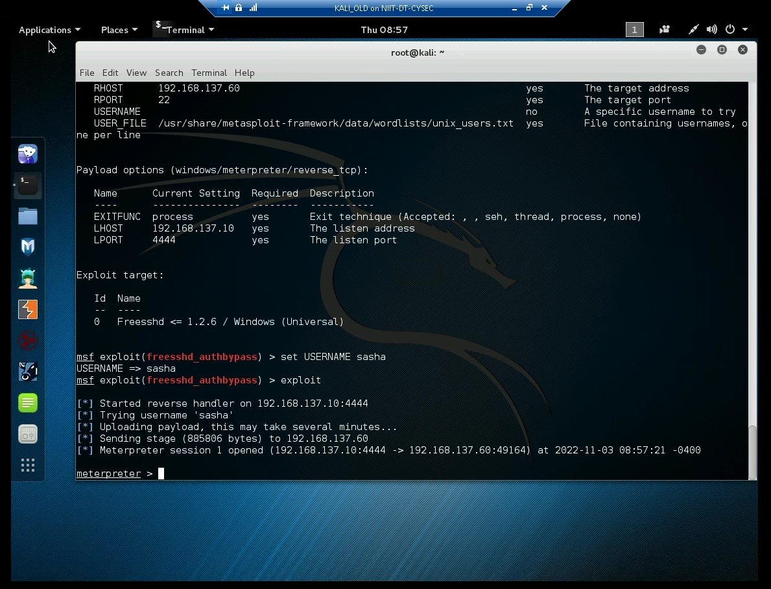
Freesshd exploit using Metasploit – freesshd_authbypass module
Notes:
CVE-2012-6066 freeSSHd through 1.2.6 allows remote attackers to bypass authentication via a crafted session, as demonstrated by an OpenSSH client with modified versions of ssh.c and sshconnect2.c.

Slide 29
Security Impact
Security Impact
The attacker may upload malware, copy all sensitive data, and use the compromised system to attack other computers or network within the same environment.
The malware will continue to steal data even after the attacker logs out and may go undetected for a log period of time.

Slide 30
Security Mitigations
FreeSSHd has not received an update in several years, like any outdated software. It is not recommended that it still be used. Instead there are alternatives like OpenSSH and bitvise. This vulnerability may still be impactful because freeSSHd is still distributed on their website and through the popular windows package manager chocolatey. On chocolatey alone, freesshd has 10,487 downloads in the last 3 years. Any of these servers that are currently running are vulnerable to this exploit unless they are configured to run as a service.
Filter application-layer protocol messages for remote services to block any unauthorized activity.
All remote services should require strong authentication before providing user access.
Limit the accounts that may use remote services. Limit the permissions for accounts that are at higher risk of compromise; for example, configure SSH so users can only run specific programs.
Enforce strong password requirements to prevent password brute force methods for lateral movement.

Slide 31
SECURITY Mitigations
By identifying sensitive systems and isolating them on their own network zone, businesses can control what type of access is allowed into these zones and restrict remote access attacks to only allow two-factor authentication.
To make it more difficult for hackers to guess your username, don't use the username for the other non-sensitive systems or in any public forums. Instead of using common terms, use out of this world names or combination of characters, symbols, and numbers that don't fit the standard username will help prevent remote access attacks.
Consider following the principle of separation of privilege. Require multiple conditions to be met before permitting access to a system resource.
Follow the principle of least privilege when assigning access rights to entities in a software system.

Slide 32
VAPT ON WEB APPLICATION AND ITS DATABASE SYSTEM
Web Application VAPT is essentially security testing methods that address the flaws that may have been overseen during the development of the web application. Web Application Security Testing helps assess, identify and address the security flaws in web applications and APIs.
VAPT helps in evaluating the existing security of the web application by rigorously pushing the defenses of the application and checking at which point it will potentially break.

Slide 33
Top Most Dangerous Web Application Vulnerabilities
Cross-Site Scripting (XSS)
Cross Site Request Forgery (CSRF)
SQL Injection

Slide 34
Cross site Scripting
Cross-site scripting (also known as XSS) is a web security vulnerability that allows an attacker to compromise the interactions that users have with a vulnerable application. It allows an attacker to circumvent the same origin policy, which is designed to segregate different websites from each other.

Slide 35
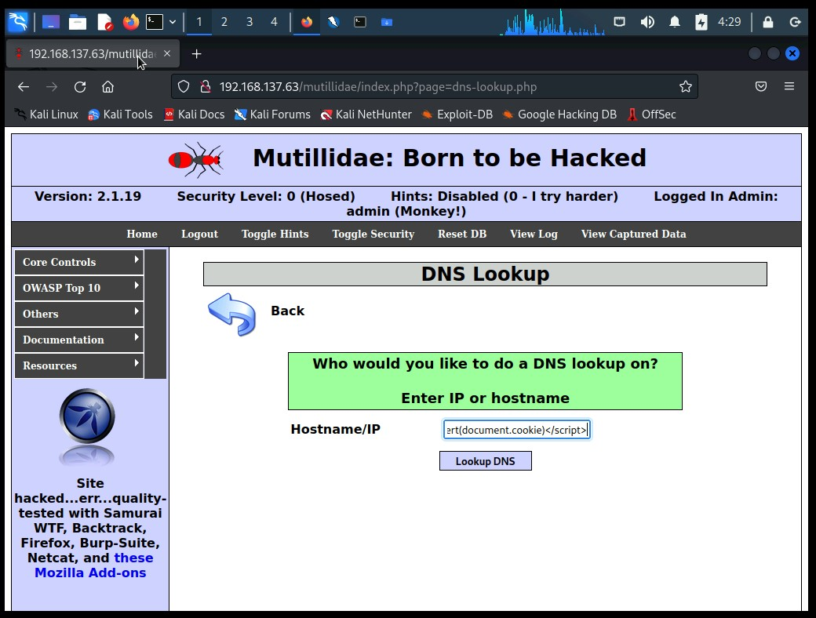
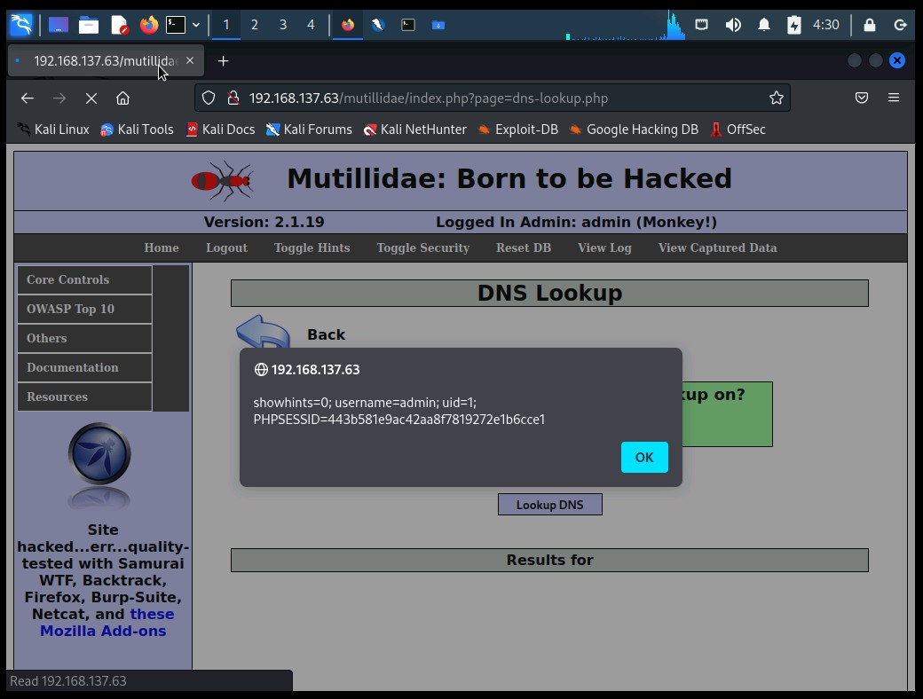

Slide 36
Security Impact
Cross-site scripting vulnerabilities normally allow an attacker to masquerade as a victim user, to carry out any actions that the user is able to perform, and to access any of the user's data. If the victim user has privileged access within the application, then the attacker might be able to gain full control over all of the application's functionality and data.

Slide 37
Security Mitigations
At the point where user input is received, filter as strictly as possible based on what is expected or valid input.
Use an application firewall that can detect attacks against this weakness. It can be beneficial in cases in which the code cannot be fixed (because it is controlled by a third party), as an emergency prevention measure while more comprehensive software assurance measures are applied, or to provide defense in depth.
To prevent XSS in HTTP responses that aren't intended to contain any HTML or JavaScript, you can use the Content-Type and X-Content-Type-Options headers to ensure that browsers interpret the responses in the way you intend.

Slide 38
Cross Site Request Forgery
Cross-Site Request Forgery (CSRF) is an attack that forces an end user to execute unwanted actions on a web application in which they’re currently authenticated. With a little help of social engineering (such as sending a link via email or chat), an attacker may trick the users of a web application into executing actions of the attacker’s choosing.

Slide 39
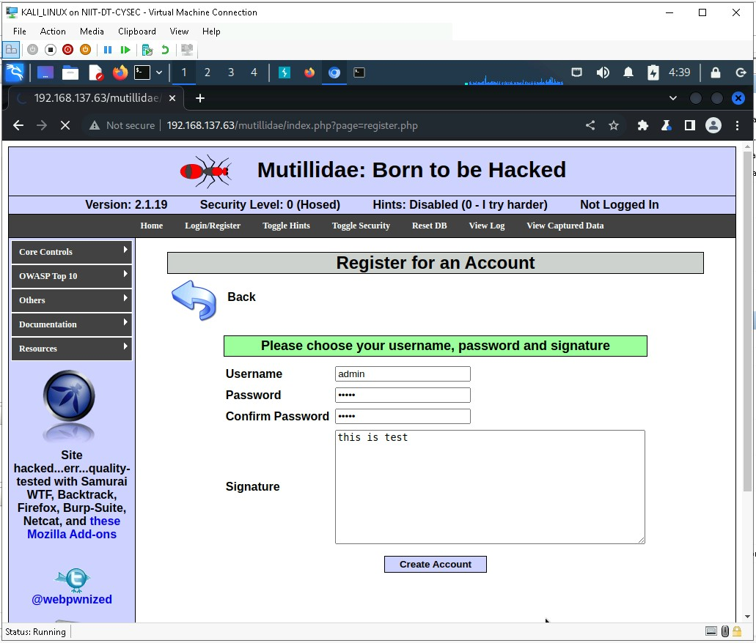
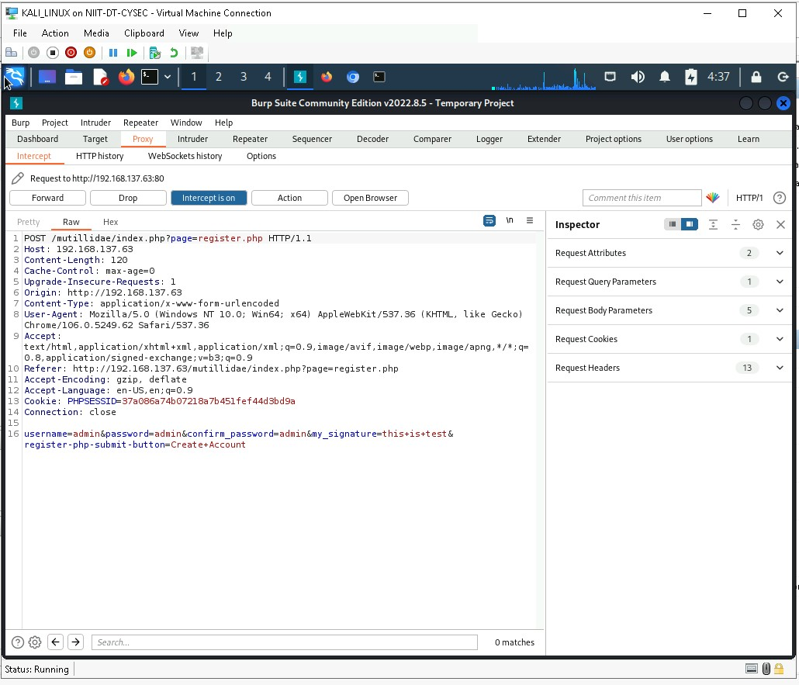
Cross Site Request Forgery using burpsuit

Slide 40
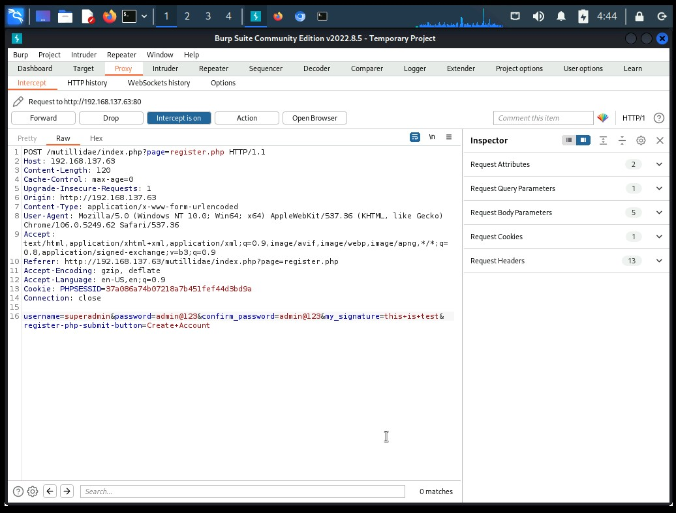
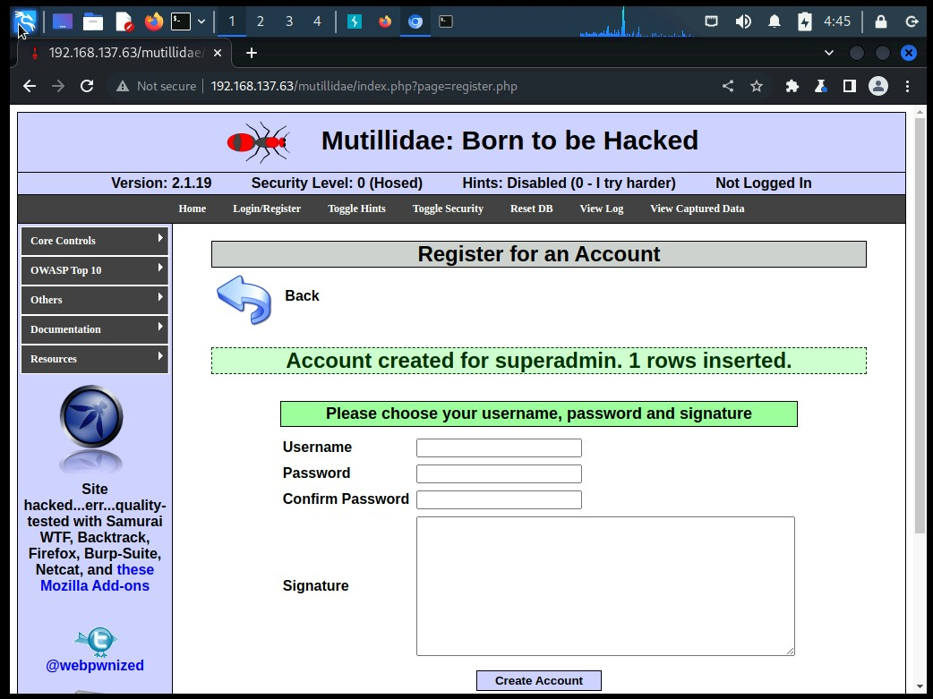

Slide 41
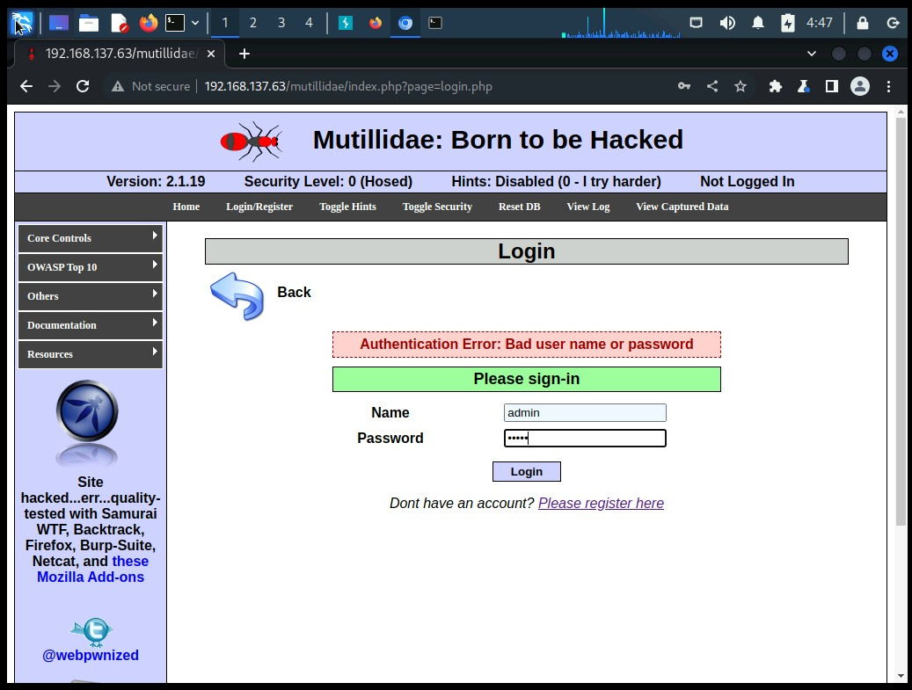
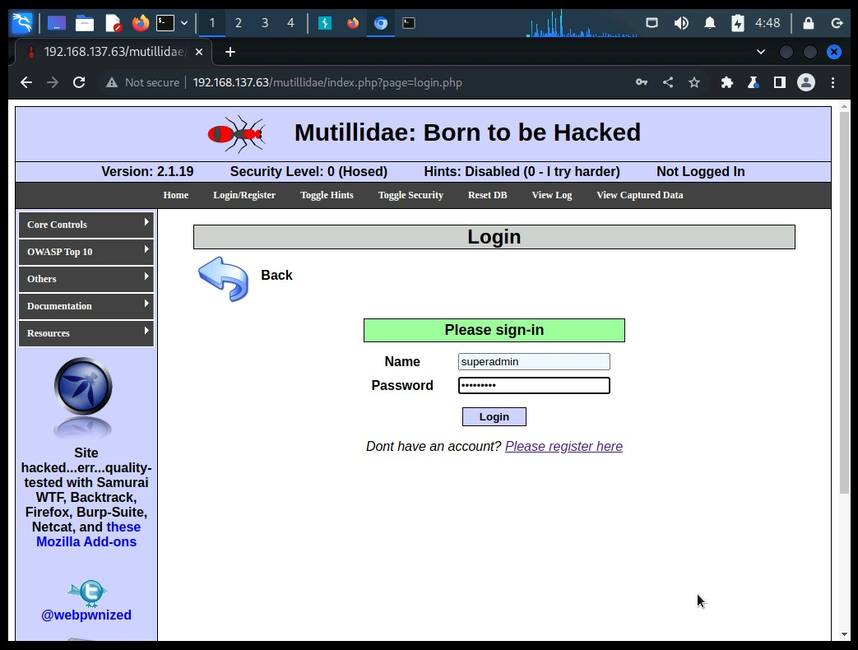

Slide 42
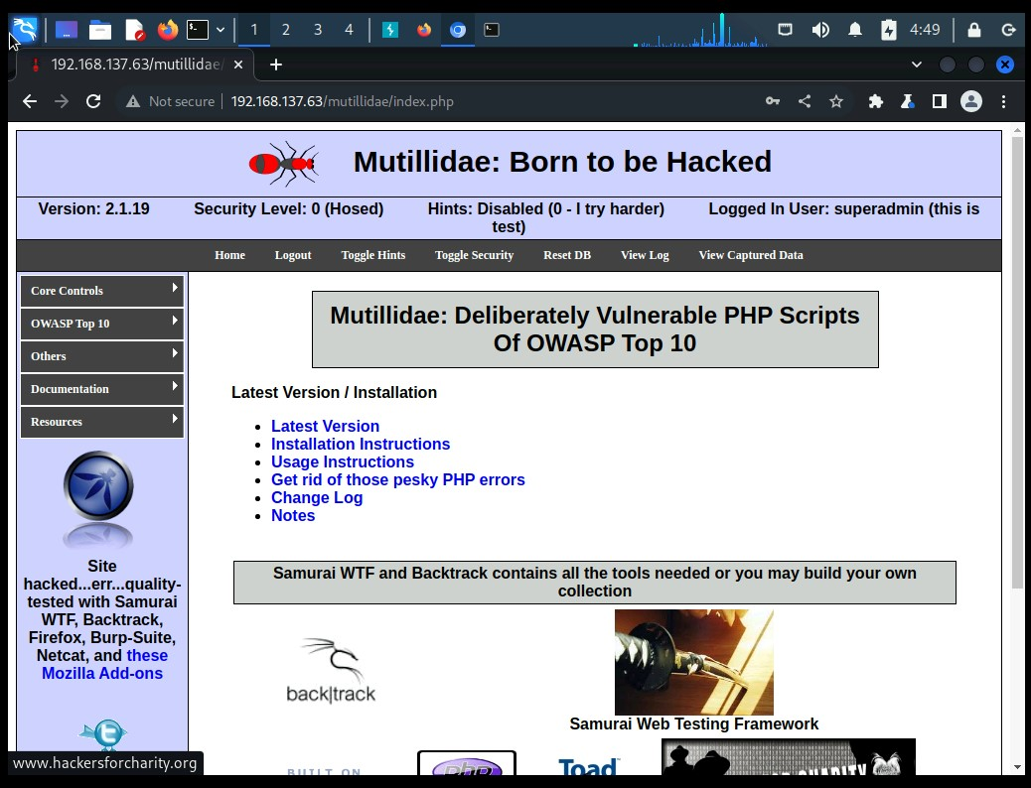

Slide 43
Security Impact
If the victim is a normal user, a successful CSRF attack can force the user to perform state changing requests like transferring funds, changing their email address, and so forth. If the victim is an administrative account, CSRF can compromise the entire web application.

Slide 44
Security Mitigations
When a user visits a site, the site should generate a pseudorandom value and set it as a cookie on the user's machine. The site should require every form submission to include this value as a form value and also as a cookie value. When a POST request is sent to the site, the request should only be considered valid if the form value and the cookie value are the same.
Because of the same-origin policy, an attacker cannot read or modify the value stored in the cookie. To successfully submit a form on behalf of the user, the attacker would have to correctly guess the pseudorandom value. If the pseudorandom value is cryptographically strong, this will be prohibitively difficult.
This technique requires Javascript, so it may not work for browsers that have Javascript disabled.
Use a vetted library or framework that does not allow this weakness to occur or provides constructs that make this weakness easier to avoid. For example, use anti-CSRF packages such as the OWASP CSRFGuard.

Slide 45
SQL injection
SQL injection (SQLi) is a web security vulnerability that allows an attacker to interfere with the queries that an application makes to its database. It generally allows an attacker to view data that they are not normally able to retrieve. This might include data belonging to other users, or any other data that the application itself is able to access.

Slide 46
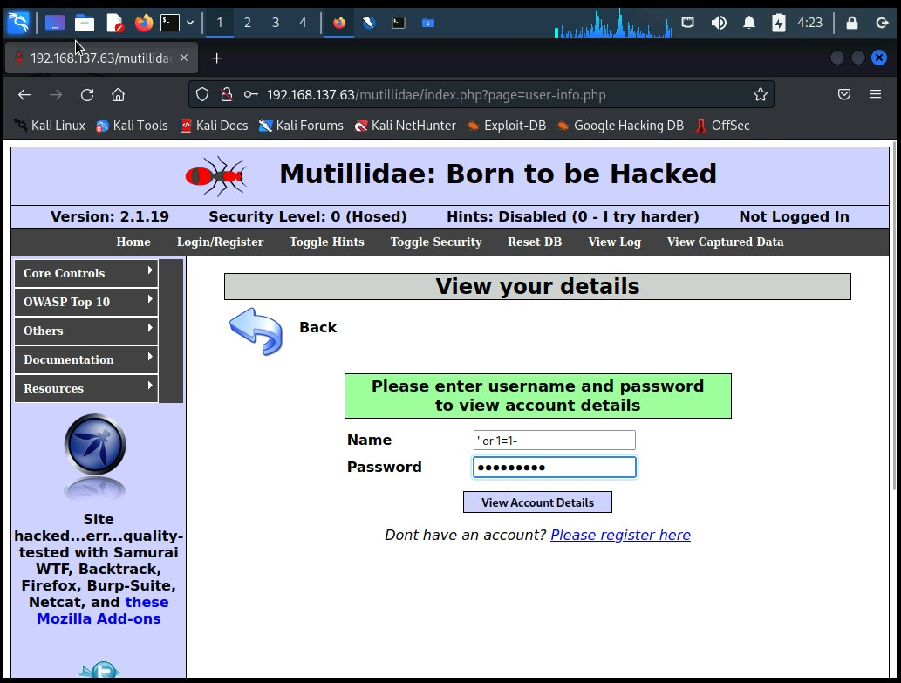
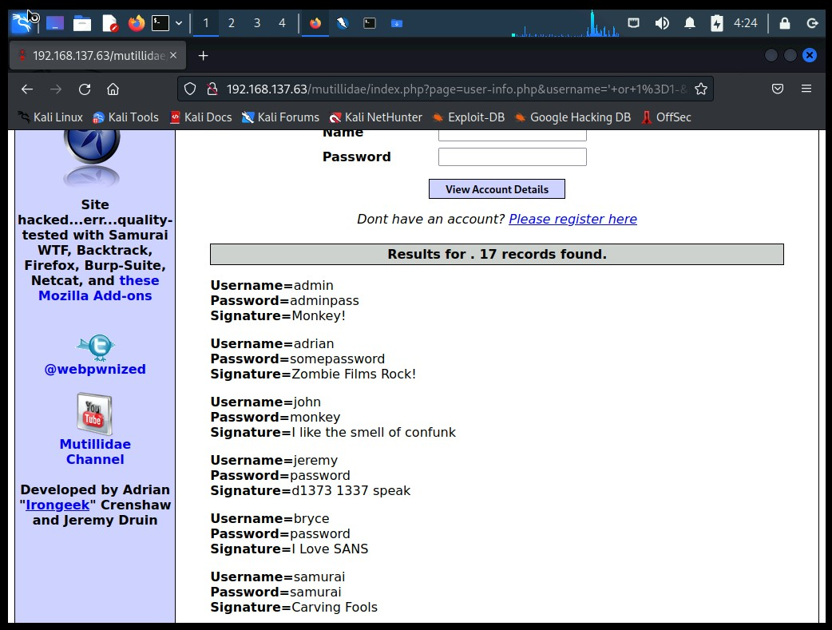

Slide 47
sqlmap
SQLmap is an open source penetration testing tool that automates the process of detecting and exploiting SQL injection flaws and taking over of database servers.

Slide 48
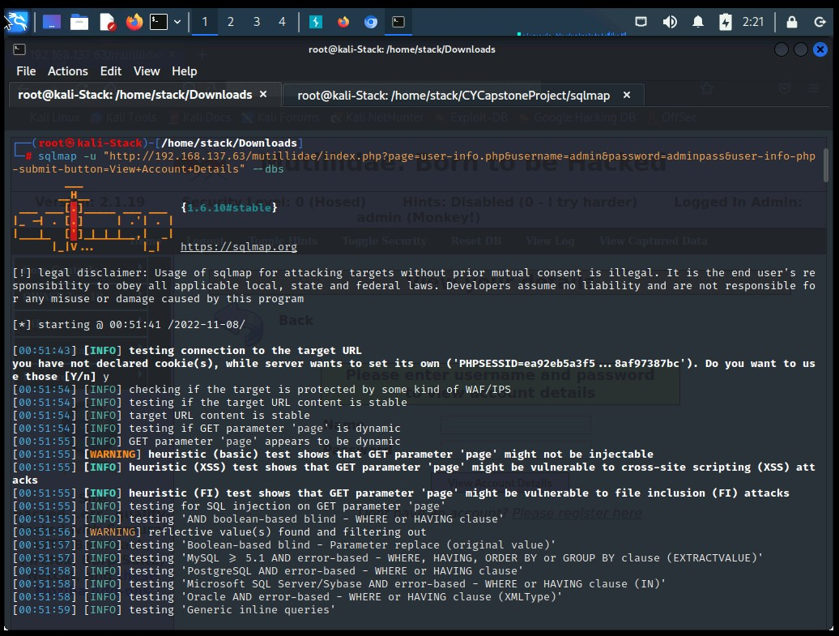
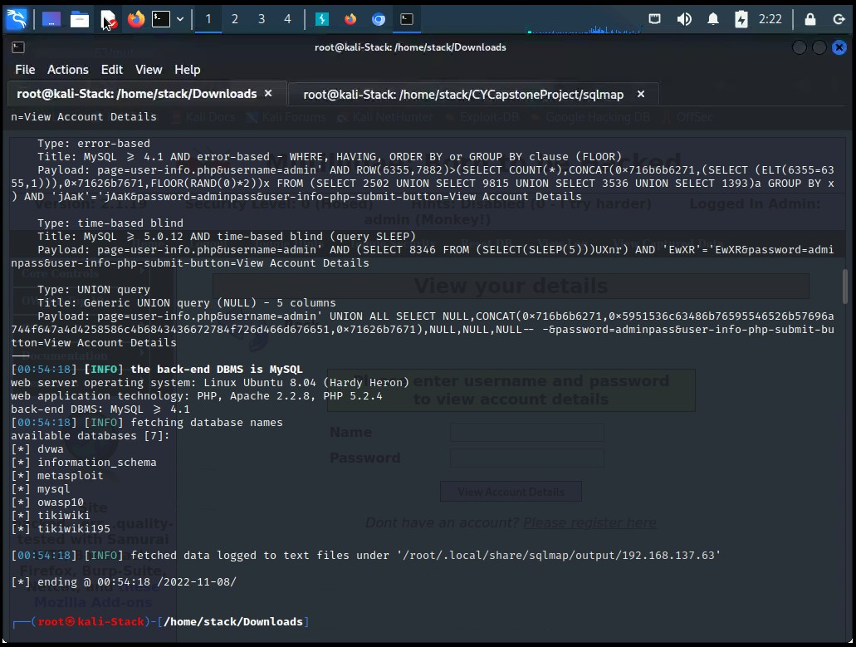

Slide 49
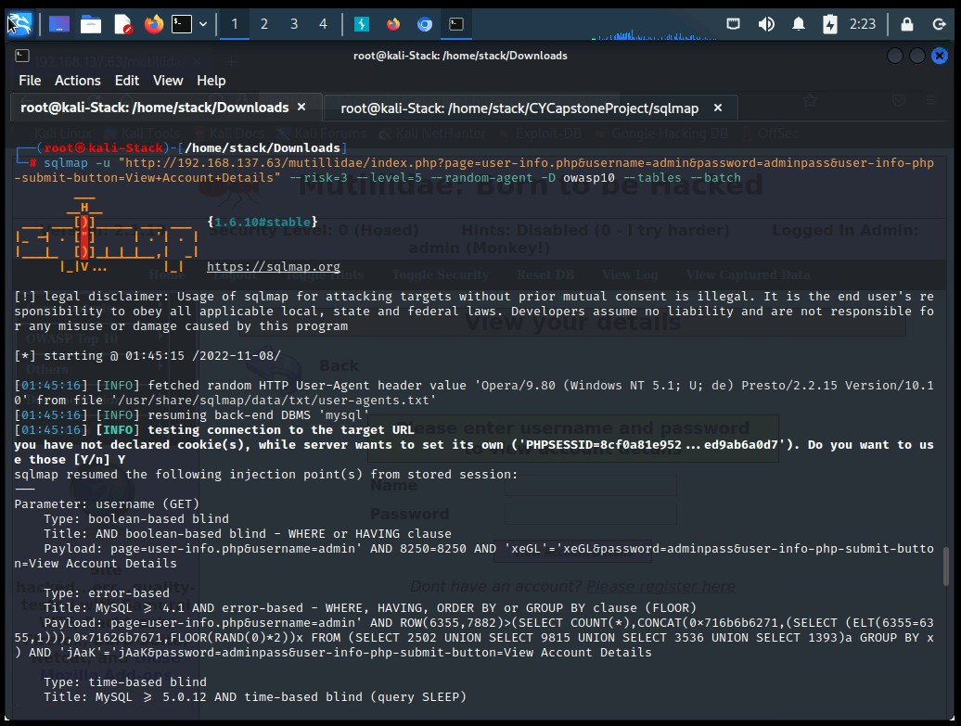
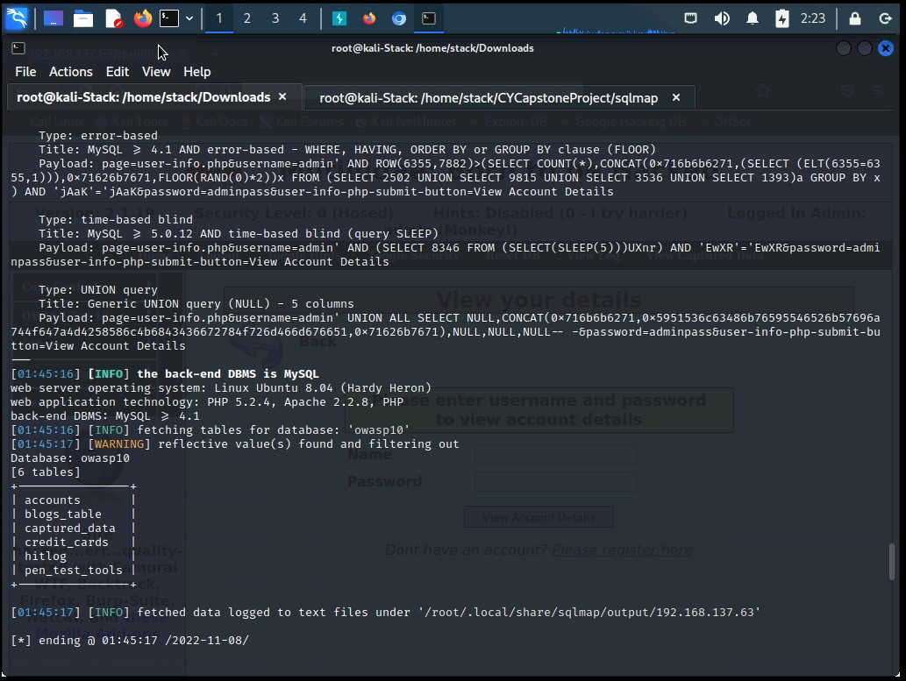

Slide 50
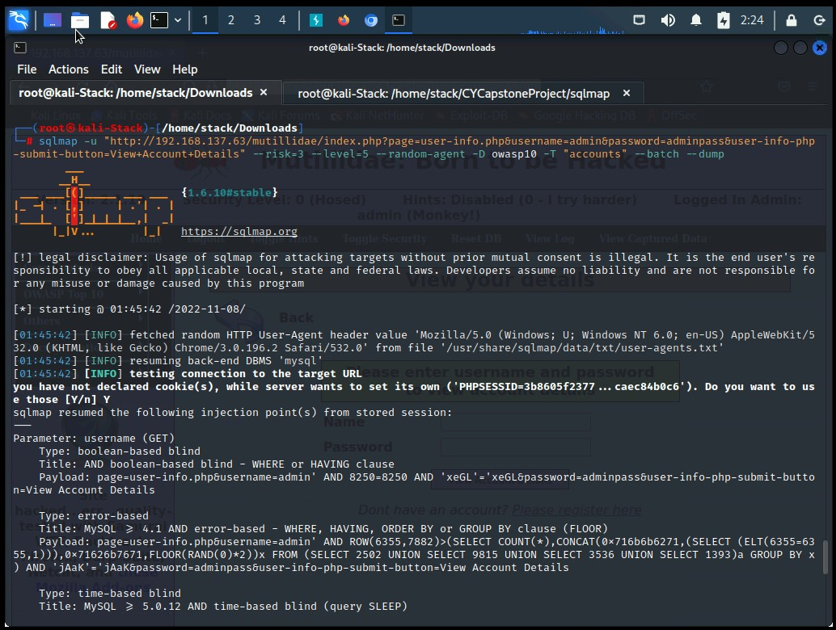
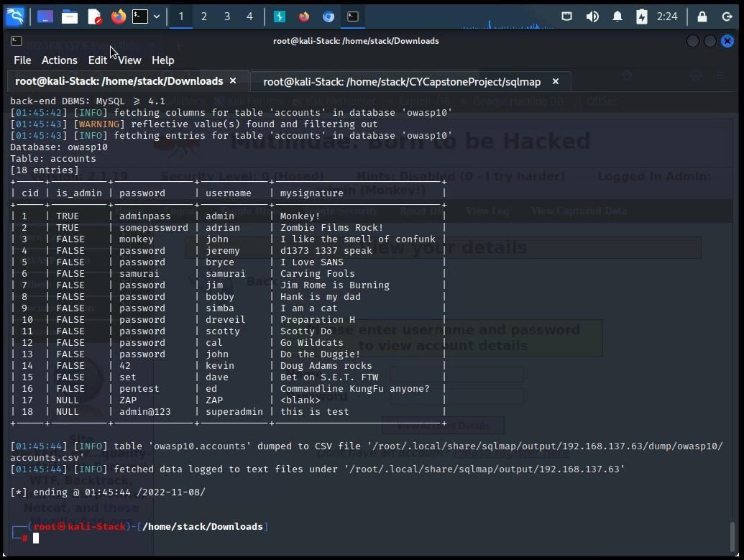

Slide 51
Security Impact
An attacker can modify or delete this data, causing persistent changes to the application's content or behavior.
An attacker can escalate an SQL injection attack to compromise the underlying server or other back-end infrastructure, or perform a denial-of-service attack.

Slide 52
SECURITY Mitigations
If available, use structured mechanisms that automatically enforce the separation between data and code. These mechanisms may be able to provide the relevant quoting, encoding, and validation automatically, instead of relying on the developer to provide this capability at every point where output is generated.
Process SQL queries using prepared statements, parameterized queries, or stored procedures. These features should accept parameters or variables and support strong typing. Do not dynamically construct and execute query strings within these features using "exec" or similar functionality, since this may re-introduce the possibility of SQL injection.

Slide 53
Challenges
SSH exploitation
Kerberosting
SQL injection using SQLmap

Slide 54
THANK YOU!

